Slide 1
ES-215 Computer Architecture and Organisation
Project - MIPS ASSEMBLER
GROUP-05

Slide 2
Assembler - Converts assembly language instructions into machine language code(8-bit hexadecimal)
Different processors have different ISA’s hence different assemblers.
In MIPS ISA, there are three types of instructions : R-type, I-type and J-type.
The Assembler we designed has two passes - First pass and second pass.
In the first pass, we take the instructions from the input file and separate the labels and store addresses of the instructions and instructions after removing additional spaces.
In the second pass, the formatted instructions are then converted into machine code based on the type of instruction and their corresponding opcodes and function codes as defined by the MIPS ISA.
In case of errors, the second pass handles different types of errors and outputs what error caused and in which instruction of the input caused the error.
The output is a 8-bit hexadecimal code which is executed by the hardware further.
The output is stored in a .bin file in binary format.

Slide 3
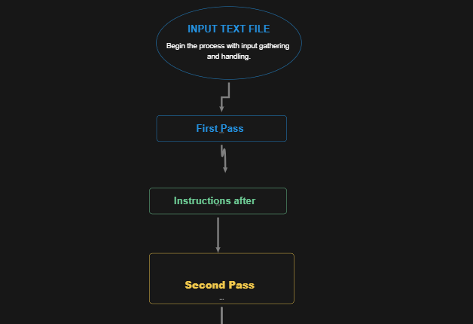
Flow of the Project

Slide 4
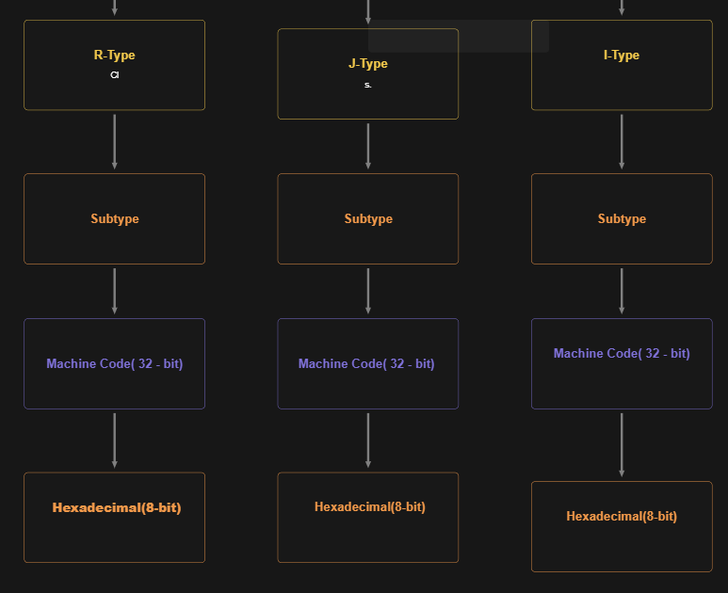

Slide 5
First Pass
Comment Handling: If a # symbol appears anywhere in a line, the tokenizer ignores everything that follows in that line of input.
Label Identification: Labels, which serve as jump destinations within the code, are identified by a colon (:) at the end of the token (e.g., LOOP:)
Instruction Recognition: The first pass clear extraneous space in each instruction i.e, if there are any extra spaces between the operands or mnemonics
Addresses: The address variable is initialised at 0, simulating the memory address of the first instruction. For each instruction encountered the address is stored and incremented by 4 to mimic MIPS's 4-byte instruction spacing.
Duplicate labels: If there are two labels with the same name, then the first pass gives an error as labels are supposed to be unique in the program for any jump or branch instructions.
By the end of first pass, we will have symbol table, commands(containing instructions after removing additional spaces) and address which have address of each instruction.

Slide 6
Second pass
In Second Pass we are converting the assembly instructions into machine code and identifing different types of errors in the input.
These instruction of the assembly has been classified into 3 types—R-type, I-type, or J-type—and maps each opcode to its corresponding binary representation. For R-type instructions, the assembler constructs a 32-bit word by combining the opcode, source, and destination registers, shift amount, and function code. For I-type instructions, it encodes the opcode, source, and destination registers, along with the immediate value. J-type instructions are encoded with the target address.After identifying the mnemonic we identify the format type for shift instruction,Multiply/Divide Instructions Move Instructions, Jump Register, Jump and Link Register System Call, Standard R-Type Instructions,Function (func) and Opcode, Machine Code Encoding: The final 32-bit machine code for the R-format instruction is constructed as follows (opcode << 26) | (rs << 21) | (rt << 16) | (rd << 11) | (shamt << 6) | func.This structure follows the MIPS encoding format for R-type instructions, positioning each field at the correct bit offset.

Slide 7
SPECIAL FEATURES:
The instruction file is given through a path, the user can use the file of his choice.
The mnemonics are defined to handle case sensitivity problems.
The number of labels and the number of different types of instructions(R, I, J) of each type is calculated.
The number of type of each instruction is displayed in the output.
The symbol, commands and address table is printed for better understanding.
The execution time and Throughput time (in seconds) is calculated and shown in the output to estimate the performance.
For branch and J instructions, the address can be taken in hexadecimal or integer
The output is in the form of a tabular form, having the address, command, binary and hexadecimal representation for better visualisation.
The output is also stored in a .bin file in the binary format which helps us in simulating for further operations.
Our MIPS simulator supports the NOP (No Operation) instruction, which performs no action for one clock cycle. It has been implemented to occupy a single clock cycle without performing any modifications to the register file or memory.
The users can run MIPS assembly code directly from the command prompt.

Slide 8
SPECIFICATIONS FOR THE INPUT INSTRUCTIONS
Do not start a command with ‘#’ , else it is considered a comment.
Anything after the ‘#’ is not read by the code in that line.
Do not end a command with ‘,’.
Label name should not have spaces (‘ ’), colon (:), or commas(,).
Each line should have only one instruction, even if a label is used.
Instructions should be given from the MIPS reference sheet (attached) only.

Slide 9
ERROR HANDLING
Types of Errors:
Invalid mnemonic Error (If the mnemonic doesn’t exist in the MIPS instructions).
Operand Validation (Invalid number of operands used in the instruction).
Undefined or Duplicate Label (If 2 labels have same name or if the label is not defined).
Invalid Register (If the given register is not from the MIPS 32 registers)
Out of range address (If the given address is not within the program range or not a multiple of 4).
Immediate out of range or invalid (If the given immediate is not valid decimal or if it is out of range).

Slide 10
References
S. Kulkarni, Computer Organisation and Architecture, Lecture slides, IIT Gandhinagar, Available: 2024-25 Sem1 ES 215 COA | General | Microsoft Teams.
NPTEL, "Computer Architecture and Organisation," YouTube, National Programme on Technology Enhanced Learning. Available: https://www.youtube.com/user/nptelhrd
Patterson, D. A., & Hennessy, J. L. (2014). Computer organisation and design: The hardware/software interface (5th ed.). Morgan Kaufmann.
Stallings, W. (2017). Computer organisation and architecture: Designing for performance (10th ed.). Pearson.

Slide 11
THANK YOU
Acknowledgement: Prof. Sameer Kulkarni

